Slide 1
AWESOME ALERTS
The basic JavaScript alert just hit puberty…

Slide 2
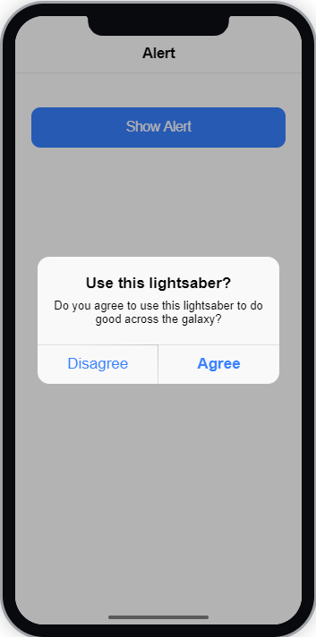

Awesome Alerts
The Alert is quite possibly one of the most used (and abused) features of old school JavaScript.
An alert can either present or collect vital user information
Alerts will display above all other content on a transparent, dark background.
Each alert requires content, but can be enhanced with a heading, subheading and/or message.
However, before we can see our alert in action we need an alert controller

Slide 3
Alert Controllers
Alerts are dynamically generated using JavaScript and TypeScript.
We want to control when they are displayed and even how they are displayed.
The Alert Controller manages this using a set of pre-defined ‘functions’
For our delivery app, we are going to look at how to show a simple text alert using the presentAlert() function
For this we need to take a closer look at the TypeScript part of our component…

Slide 4
CHALLENGE TIME!
Create a basic text alert for your mobile application in an appropriate place
For bonus points, modify the alert to not only show information, but also collect it
Share a screen shot on our Discord Community!

